Slide 1

Shift to Electric
North America's Path to Market Leadership
Strategic focus on Hybrid/Electric models for Q2 2026

Slide 2
The Challenge
BMW EuroDrive faces inconsistent sales classifications across global regions despite a robust portfolio.
High-performance models struggling in regions with fuel price spikes
Overstocked inventory in underperforming regions
Unclear Price-to-Mileage efficiency drivers for "High“ sales classification

Slide 3
Dataset Overview
Scope
Global sales data from 2010 to 2024 across Europe, North America, Asia, Africa, Middle East and South America.
Key Variables
Fuel type, Mileage KM, Region, Price, Model, Year, Sales Classification
Focus Region
North America market analysis with emphasis on fuel type performance and price

Slide 4
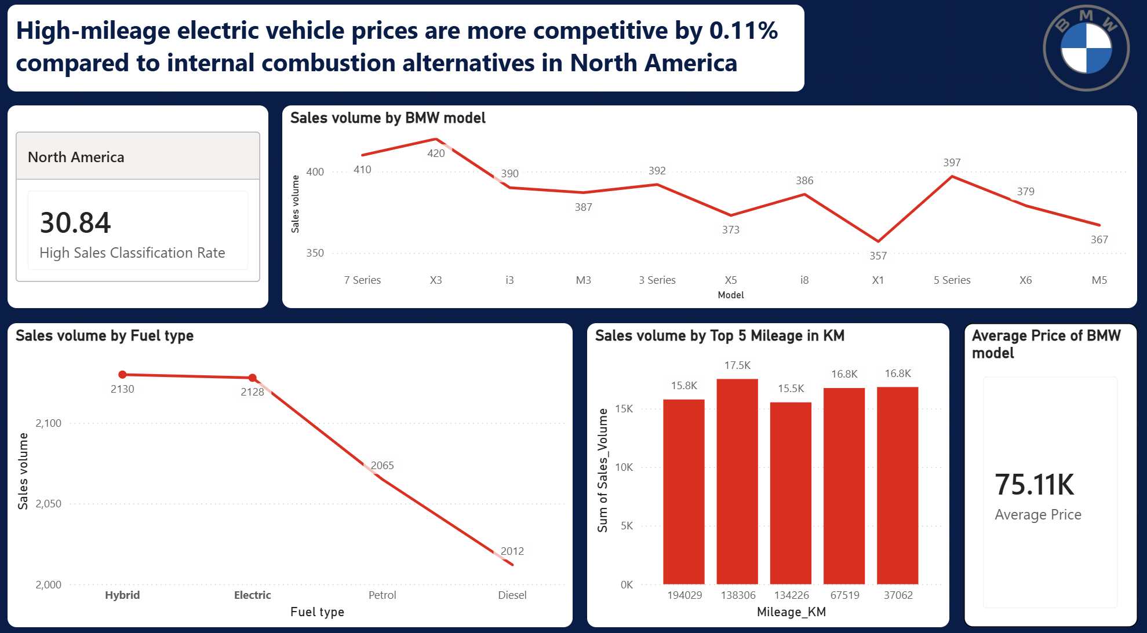
Dashboard Insights: Hybrid/Electric Vehicles

Slide 5
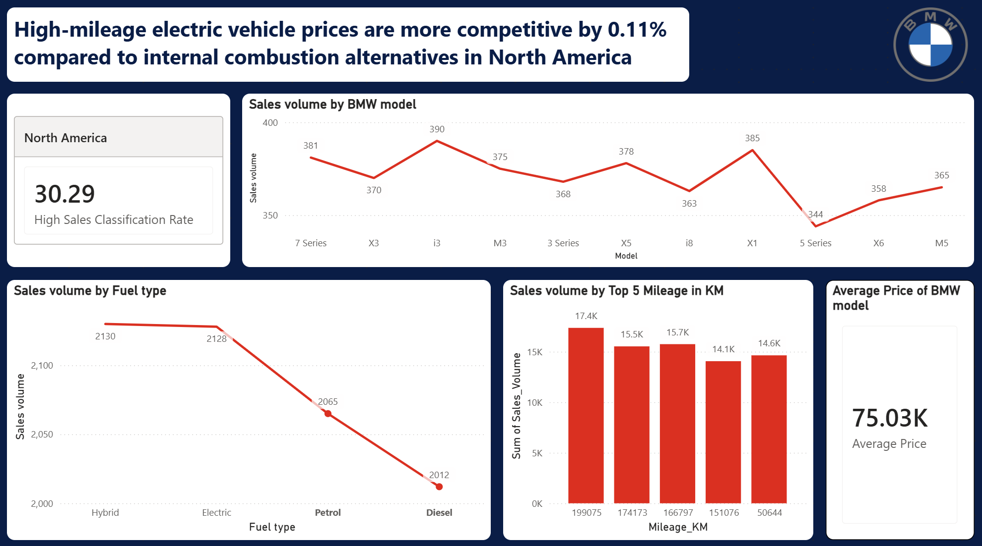
Dashboard Insights: ICE Vehicles

Slide 6
Key Performance Metrics
Hybrid/Electric vehicles
  High Sales Classification Rate: 30.29%
ICE vehicles
  High Sales Classification Rate: 30.29%
Hybrid & Electric lead with 2,128+ units sold each
7 Series and X3 are top-performing models by volume
High-mileage vehicles sustain strong sales at $75K avg price

Slide 7
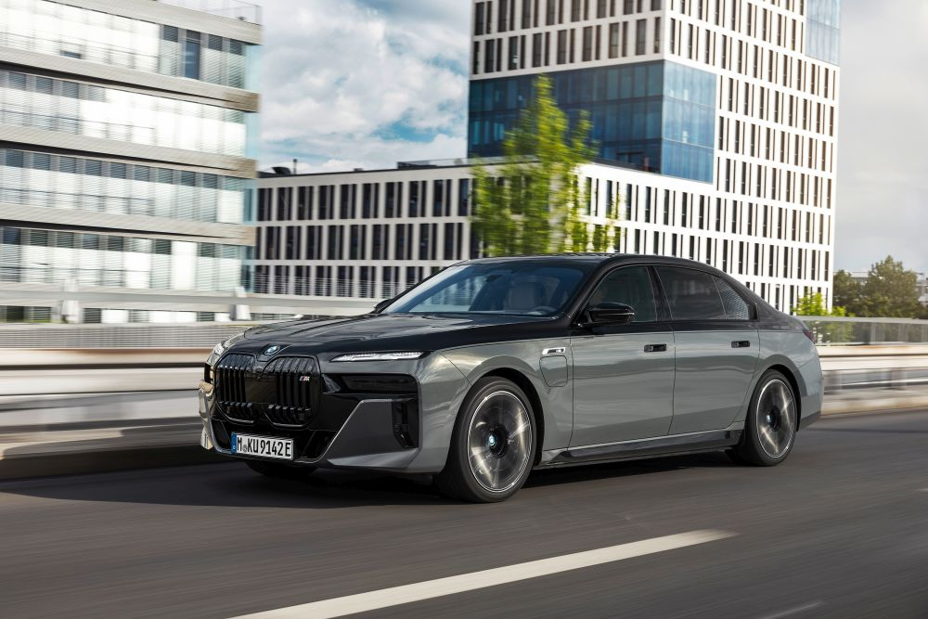
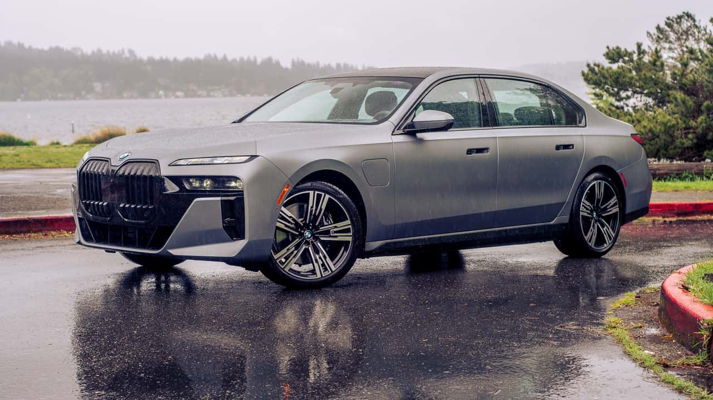
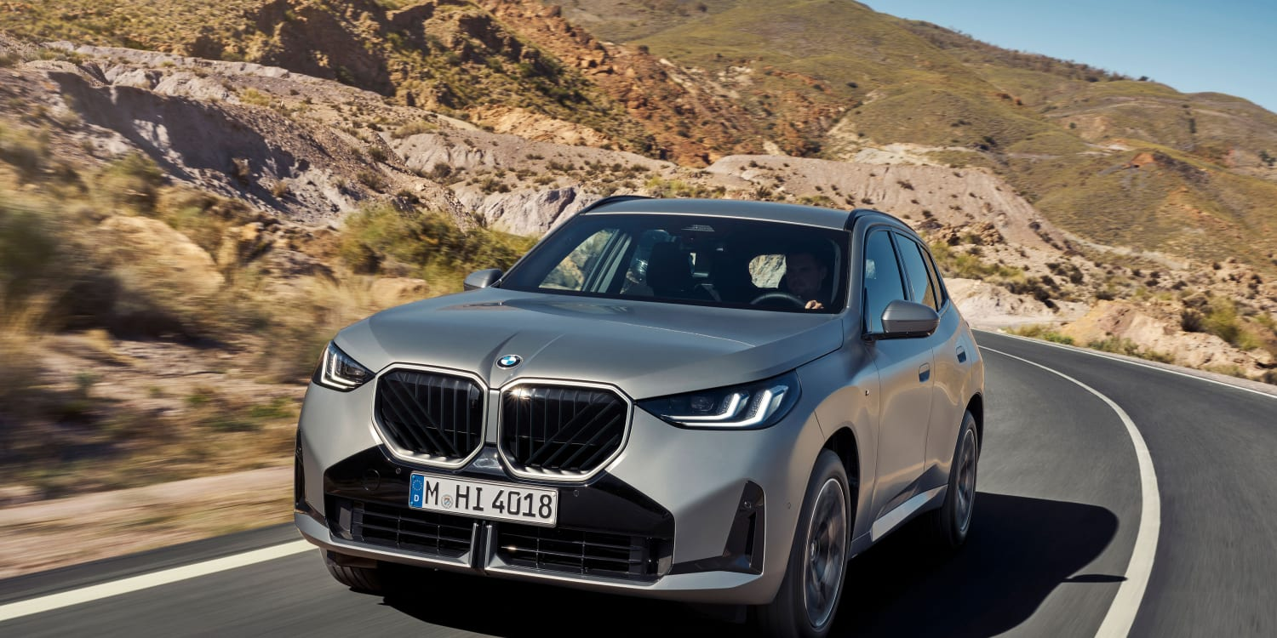
Strategic Recommendations
Shift Q2 inventory to 7 Series (eg. 750e xDrive, M760e xDrive) and X3 (eg. 30e xDrive) Hybrid configurations
Implement tiered pricing for EVs exceeding 150,000 KM (since original battery warranties last 8 years or 160,000 KM)
Target pricing slightly below $75K for high-mileage units
Market 7 Series and X3 Hybrids as "efficiency leader" in high fuel-price regions

Slide 8
Thank You
Questions?
BMW EuroDrive Leadership Team

